Slide 1
CSC 112: Computer Operating Systems Lecture 3 Synchronization
Department of Computer Science,
Hofstra University
Acknowledgement: Lecture slides based on UC Berkeley CS 162: Operating Systems and System Programming
And NTNU course on Operating Systems

Slide 2
Outline
Concurrency & Locks
Spinlocks

Slide 3
Concurrency
#include <stdio.h>
#include <stdlib.h>
#include "common.h"
#include "common_threads.h”
int counter = 0;
int loops;
void *worker(void *arg) {
int i;
for (i = 0; i < loops;i++) {counter++; }
return NULL;
}
int main(int argc, char *argv[])
{
if (argc != 2){
fprintf(stderr, "usage: threads <loops>\n");
exit(1); }
loops = atoi(argv[1]);
pthread_t p1, p2;
printf("Initial value : %d\n", counter); pthread_create(&p1, NULL, worker, NULL); pthread_create(&p2, NULL, worker, NULL); pthread_join(p1, NULL);
pthread_join(p2, NULL);
printf("Final value : %d\n", counter);
return 0;
}
This concurrent program has a race condition, and may produce different final values of counter for different runs, depending on different interleavings of worker threads

Slide 4
Race Condition
Incrementing counter has 3 instructions in assembly code:
ldr w8, [x9]: Read the value of counter at memory address x9 into register w8
add w8, w8, #0x1: increment the value of register w8 by 1
str w8, [x9]: write the new value of counter in register w8 to memory address x9
When both threads read the same value of counter before writing to it, counter is incremented only by 1 instead of by 2!
counter
Thread 1
Thread 2
ldr w8, [x9]
add w8, w8, #0x1
str w8, [x9]
100
101
100
ldr w8, [x9]
add w8, w8, #0x1
str w8, [x9]
101
101
counter++;
str w8, [x9]
101
ldr w8, [x9]
add w8, w8, #0x1
str w8, [x9]
ldr w8, [x9]
add w8, w8, #0x1
str w8, [x9]
Thread 1
Thread 2

Slide 5
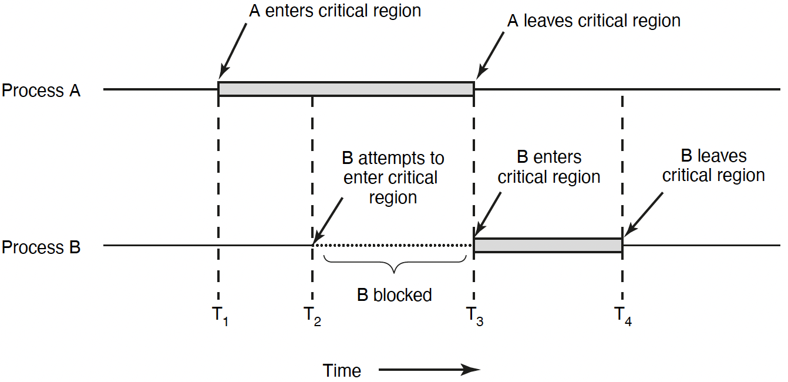
Race Condition & Critical Section
Race condition:
Multiple threads of execution update shared data variables, and final results depend on the execution order
Race condition leads to non-deterministic results: different results even for the same inputs
To prevent race condition, a critical section should be used to protect shared data variables
A critical section is executed atomically
Mutual exclusion (mutex) ensures that when one thread is executing in its critical section, no other thread is allowed to execute in that critical section
Notes:
The execution of the critical sections by the threads is mutually exclusive in time
Programmers must make sure that some high-level code sections are executed atomically
Atomic operation: It completes in its entirety without worrying about interruption by any other potentially conflict-causing thread
1. Mutual exclusion. If process Pi is executing in its critical section, then no other processes can be executing in their critical sections.
2. Progress. If no process is executing in its critical section and some processes wish to enter their critical sections, then only those processes that are not executing in their remainder sections can participate in deciding which will enter its critical section next, and this selection cannot be postponed indefinitely.
3. Bounded waiting. There exists a bound, or limit, on the number of times that other processes are allowed to enter their critical sections after a process has made a request to enter its critical section and before that request is granted.

Slide 6

Lock to Protect a Critical Section
Count
Value
Thread 1
Thread 2
ldr w8, [x9]
add w8, w8, #0x1
str w8, [x9]
100
101
101
101
ldr w8, [x9]
add w8, w8, #0x1
str w8, [x9]
102
Lock it
102
Critical section: a piece of code that accesses a shared resource, usually a variable or data structure
Correctness of a concurrent program:
Mutual exclusion: Only one thread in critical section at a time
Progress (deadlock-free): If several simultaneous requests, must allow one to proceed
Bounded (starvation-free): Must eventually allow each waiting thread to enter
Lock it
Notes:
Solution:
Mutual exclusion: Only one thread in critical section at a time
Progress (deadlock-free): If several simultaneous requests, must allow one to proceed
Bounded (starvation-free): Must eventually allow each waiting thread to enter

Slide 7
Locks
A lock is a variable
Objective: Provide mutual exclusion (mutex)
Two states
Available or free
Locked or held
lock(): tries to acquire the lock
unlock(): releases the lock that was previously acquired
lock_t mutex
void *worker(void *arg) {
int i;
for (i = 0; i < loops;i++) {
lock(&mutex);
counter++;
unlock(&mutex)}
return NULL;
}
Notes:
mutual exclusionA good lock:
Mutual exclusion
Fairness: progress, no starvation
Performance: overhead to grab and release lock

Slide 8
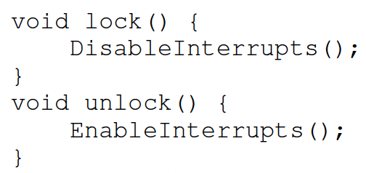
Locks: Disable Interrupts
An early solution: disable interrupts for critical sections
Problems:
System becomes irresponsive if interrupts are disabled for a long time
Does not work on multiprocessors
Notes:
Abused usage

Slide 9
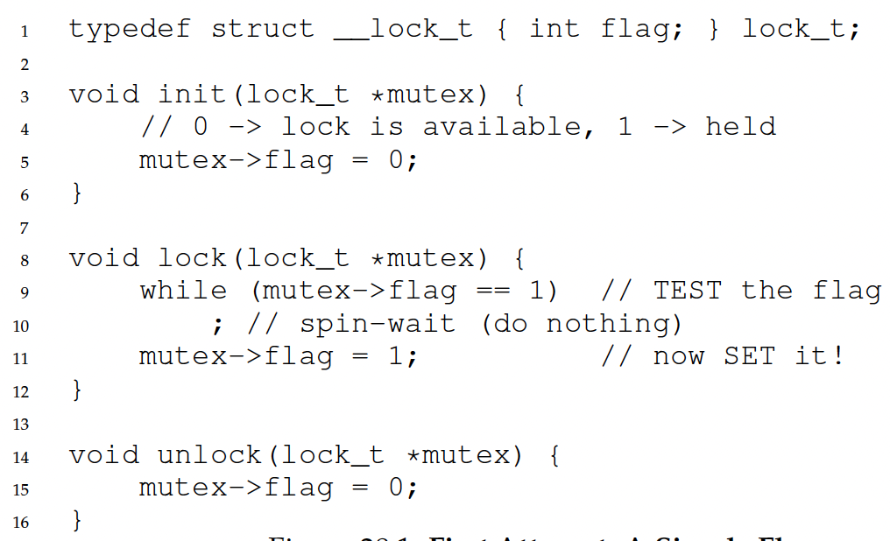
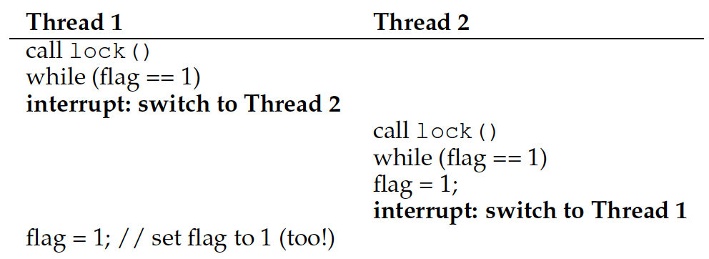
Locks: Loads/Stores
This implementation does not ensure mutual exclusion, since both threads may grab the lock:
After Thread 1 reads flag==0 and exits the while loop, it is preempted/interrupted by Thread 2, which also reads flag==0 and exits the while loop. Then both threads set flag=1 and enter the critical section.
Root cause: Lock is not an atomic operation!
flag = 0
Notes:
Another problem: performance overhead!

Slide 10
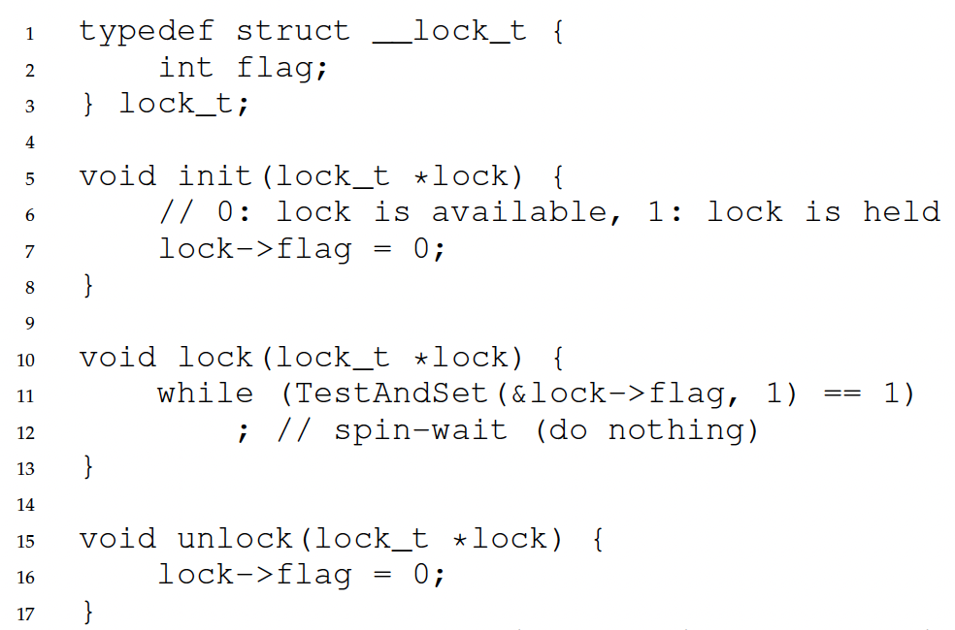
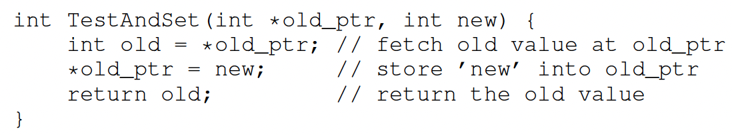
Locks: Test-And-Set
How to provide mutual exclusion for locks?
Get help from hardware!
CPUs provide special hardware instructions to help achieve mutual exclusion
The TestAndSet (TAS) instruction tests and modifies the content of a memory word atomically
Locking with TAS: TAS fetches the old value of lock->flag into variable old, sets lock->flag to 1, then return variable old, all in one atomic operation
If lock-flag==0, then lock() sets it to 1 and returns old=0, so the thread exits the while loop and enters critical section
If lock-flag==1, then lock() returns old=1, so the thread spins in the while loop and does not enter critical section

Slide 11
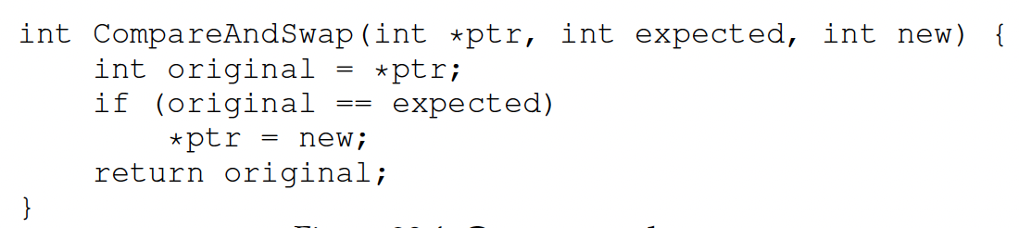
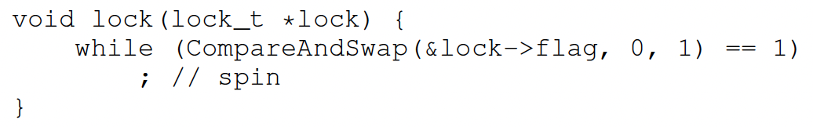
Locks: Compare-And-Swap
Another hardware primitive: compare-and-swap (CAS)
Locking with CAS: CAS fetches the old value of lock-flag into variable original, compares original with expected (0), and if they are equal (lock-flag==0), sets lock->flag to 1, then return variable original, all in one atomic operation
If lock-flag==0, then lock() sets it to 1 and returns original=0, so the thread exits the while loop and enters critical section
If lock-flag==1, then lock() returns original=1, so the thread spins in the while loop and does not enter critical section
Compared to TAS, assignment *ptr=new is not executed if lock-flag==1, hence slightly less overhead

Slide 12
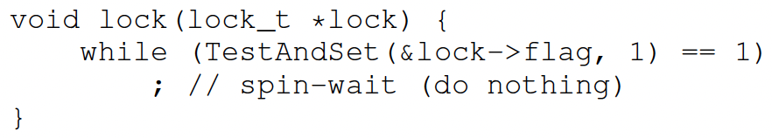
Locks: Busy Waiting
Both TAS and CAS are spinlocks based on busy waiting
A thread is stuck in a while loop endlessly checking lock->flag if the lock is held by others
Goals achieved?
Mutual exclusion (Yes!)
Fairness (NO!!)
Performance (NO!!)

Slide 13
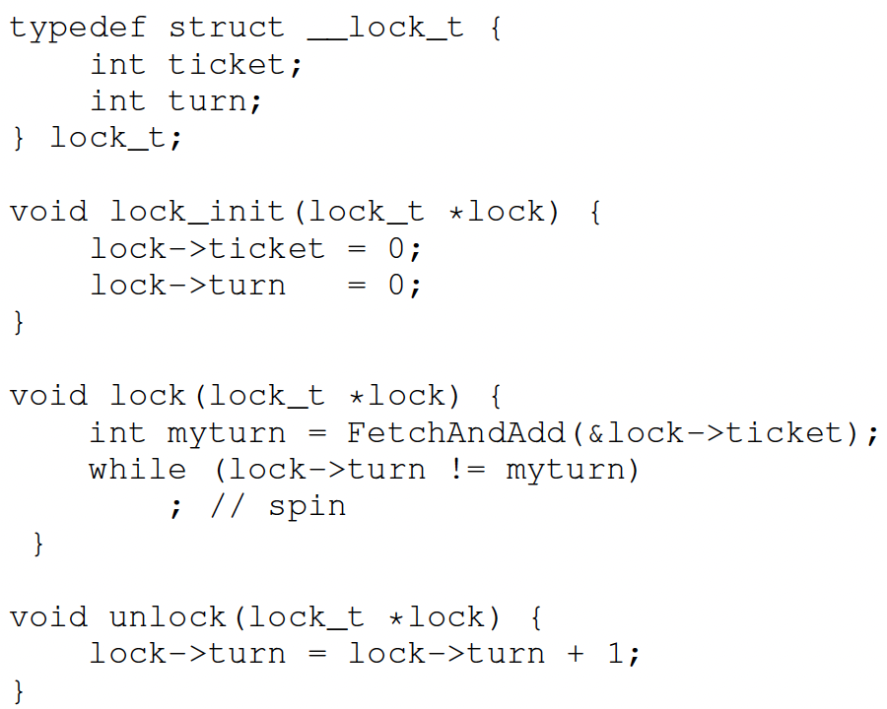
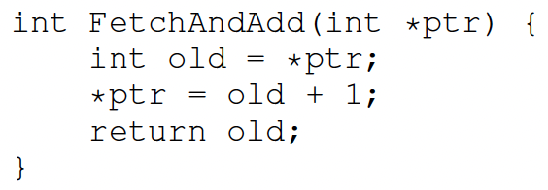
Ticket Lock
Basic spinlocks are not fair and may cause starvation
Ticket lock uses hardware primitive fetch-and-add to guarantee fairness
Lock:
Use fetch-and-add on the ticket value
The return value is the thread’s ”turn” value
Unlock:
Increment the turn
Notes:
ticket and turn

Slide 14
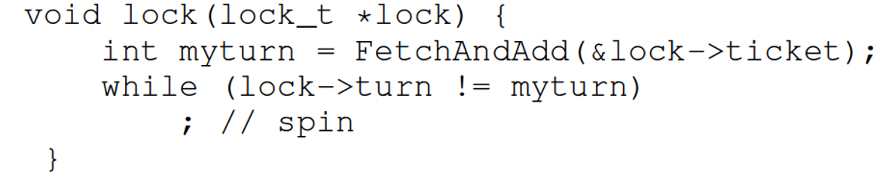
Ticket Lock
Initial value tickets=0 turn=0
 | Ticket | Turn
A lock() | 1 | 0
B lock() | 2 | 0
C lock() | 3 | 0
A unlock()
A lock()
B unlock()
C unlock()
A unlock()
 | myturn
A | 0
B | 1
C | 2

Slide 15
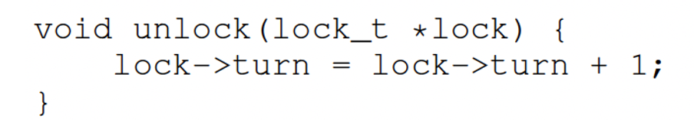
Ticket Lock
Initial value tickets=0 turn=0
 | Ticket | Turn
A lock() | 1 | 0
B lock() | 2 | 0
C lock() | 3 | 0
A unlock() | 3 | 1
A lock() | 4 | 1
B unlock()
C unlock()
A unlock()
 | myturn
A | 3
B | 1
C | 2

Slide 16
Ticket Lock
Initial value tickets=0 turn=0
 | Ticket | Turn
A lock() | 1 | 0
B lock() | 2 | 0
C lock() | 3 | 0
A unlock() | 3 | 1
A lock() | 4 | 1
B unlock() | 4 | 2
C unlock() | 4 | 3
A unlock() | 4 | 4
 | myturn
A | 3
B | 1
C | 2

Slide 17
Spinlocks: Performance
Can be fast:
Locks held for a short time
Pros: No context switch
But also, can be slow:
Locks held for a long time
Cons: Spinwaiting is wasteful

Slide 18
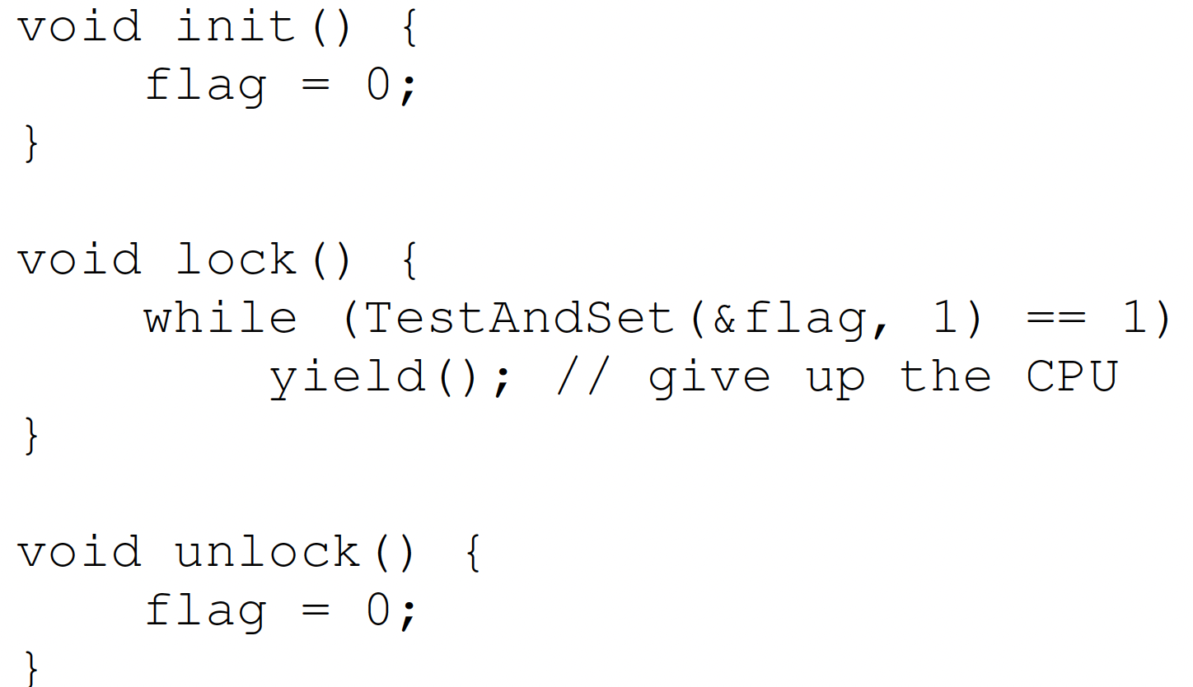
Spinlocks: yield()
Busy waiting with spinlocks is wasteful of CPU time
Instead of spinning, just give up the CPU to anther process/thread
Notes:
yield is simply a system call that moves the caller from the
running state to the ready state, and thus promotes another thread to
running. Thus, the yielding thread essentially deschedules itself.
a relatively large number of threads attempting to acquire the lock
Even with yield(), spinning is slow with high thread contention

Slide 19
Spinlocks: Locks with Queue
Locks with queue
Sleep and put thread on a queue instead of spinning
This can guarantee that starvation does not happen as long as all threads will relinquish locks
An example from Solaris
Park(): put the calling thread to sleep
Unpark(ThreadID): to walk up a specific thread with ThreadID

Slide 20
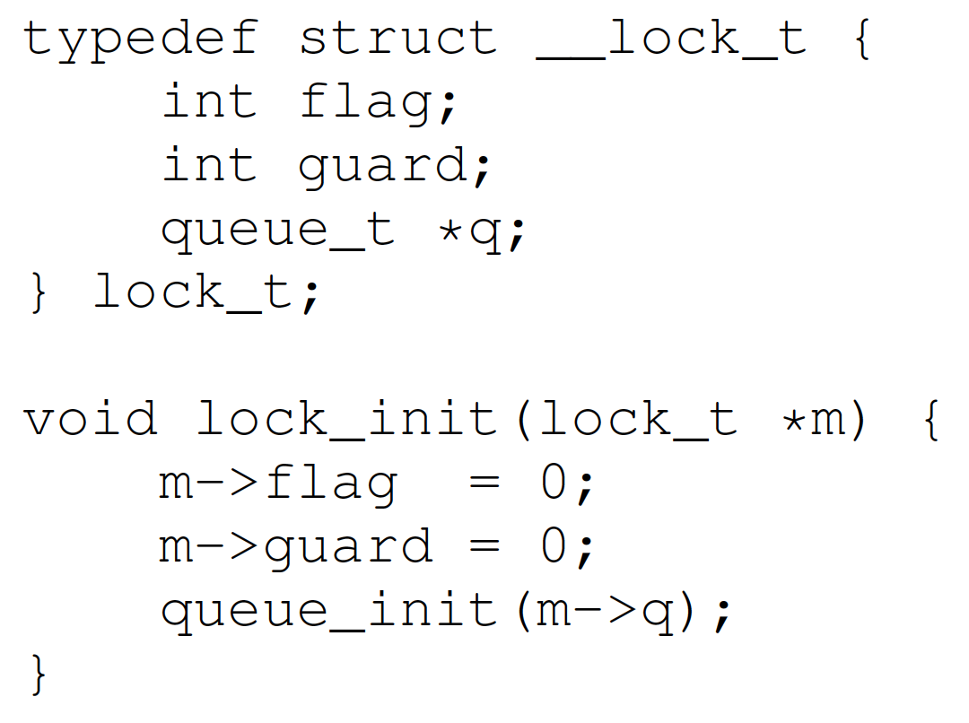
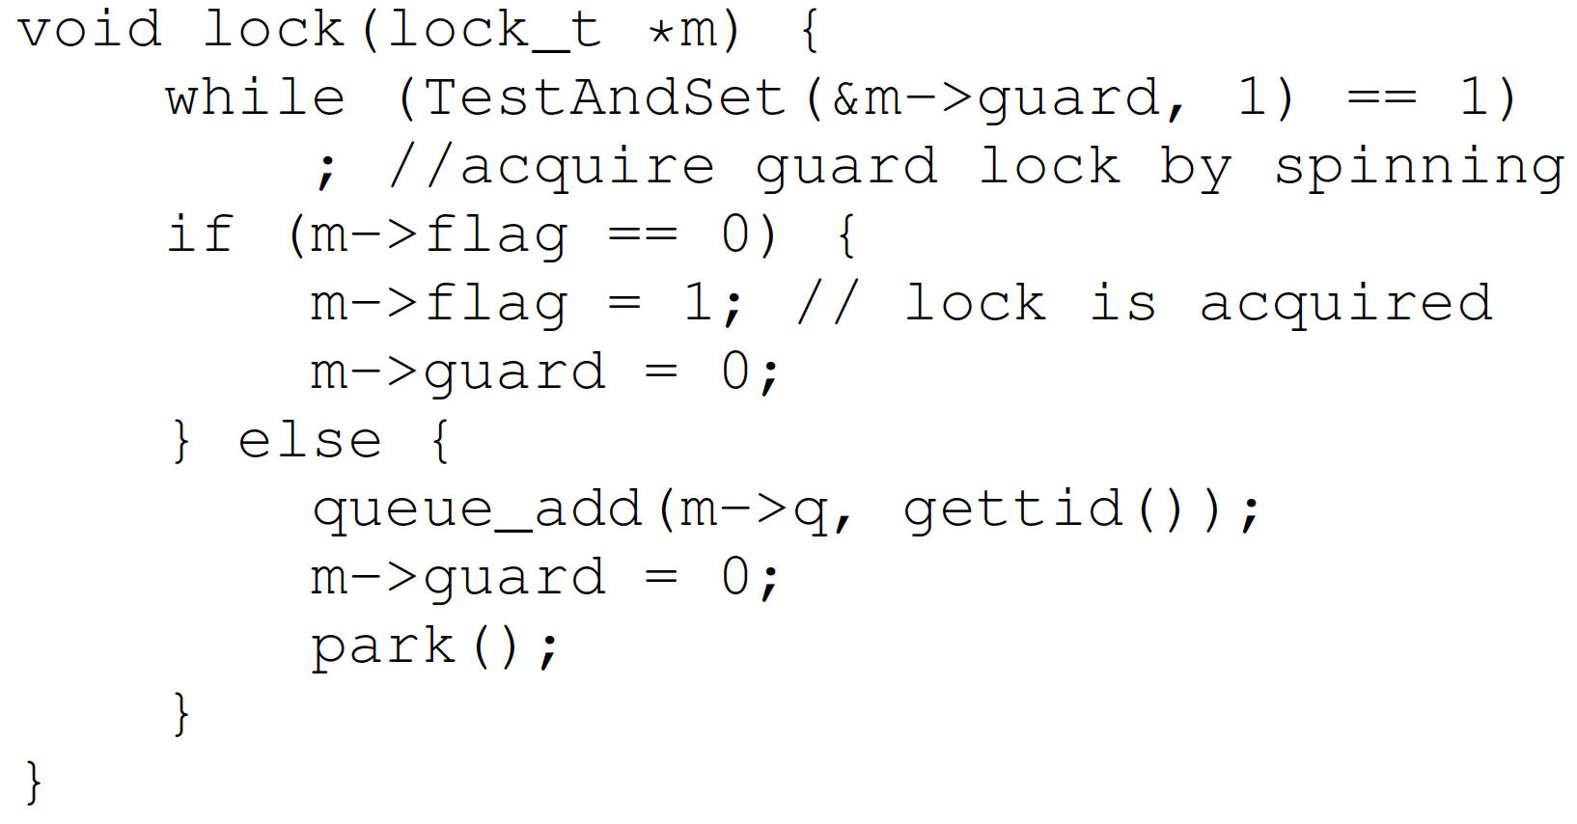
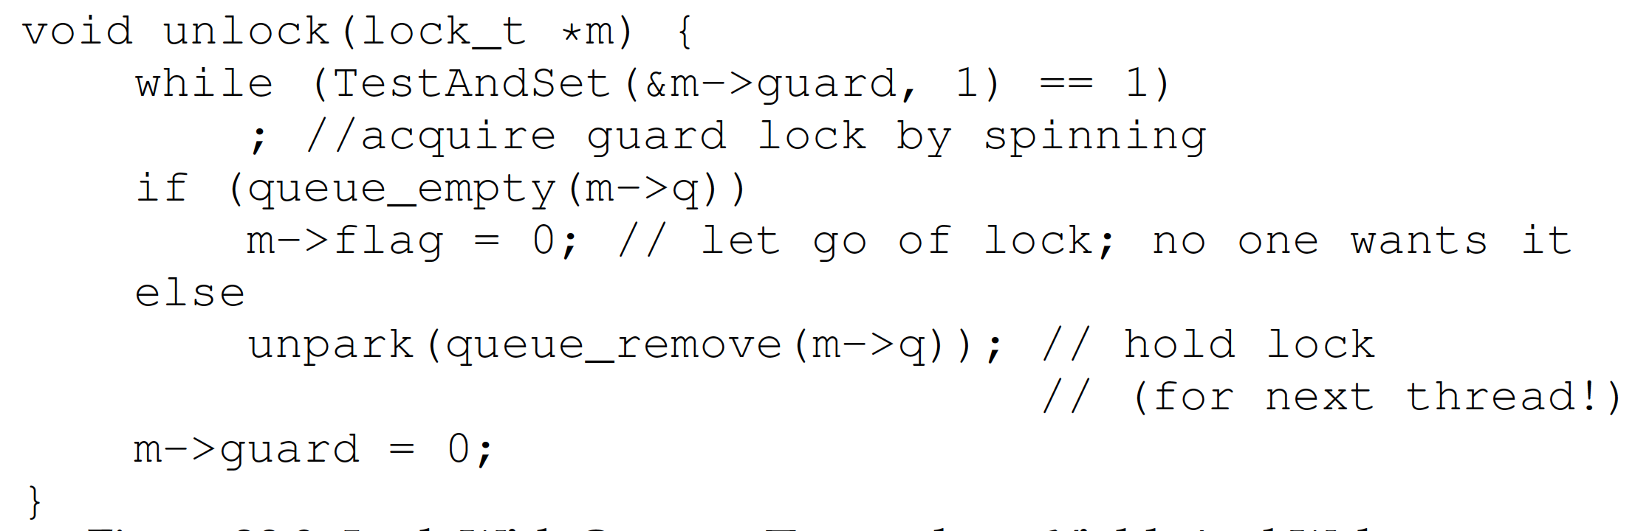
Spinlocks: Locks with Queue
Notes:
Guard is used to prevent races in updating the queue.

Slide 21
Spinlocks: Two Phase locks
Lock released quickly ▶︎ Spin-wait
Lock released slowly ▶︎ Sleep/block
Two phase lock is a hybrid approach that combines both spin-wait and sleep/block
First phase: the lock spins for a while
Second phase: if the lock is not acquired in the first phase, put the calling thread to sleep.
Adaptive Mutexes: If a thread has a locked adaptive mutex and the process/thread holding the adaptive mutex is running, the adaptive mutex executes busy waiting. Otherwise, it just blocks the thread.

Slide 22
Summary
Locks: Provide a mutual exclusion
Spinlocks:
Test-And-Set()
Compare-and-swap()
Yield()
Locks with Queue
Two phase locks
Adaptive mutex

Slide 23
Outlines
Semaphore
Semaphore operations
Binary Semaphore
Semaphore for ordering
Semaphore for P/C
Deadlock
Semaphore for P/C without deadlock

Slide 24
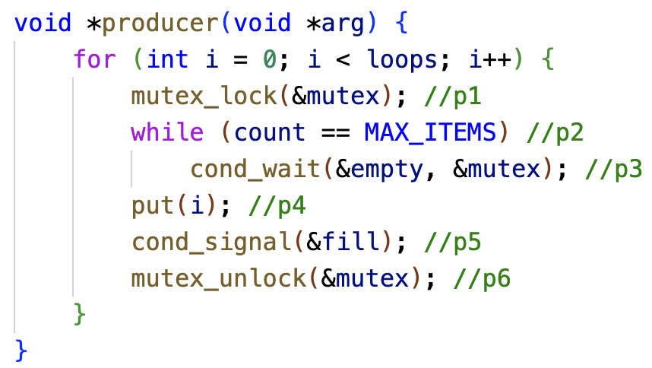
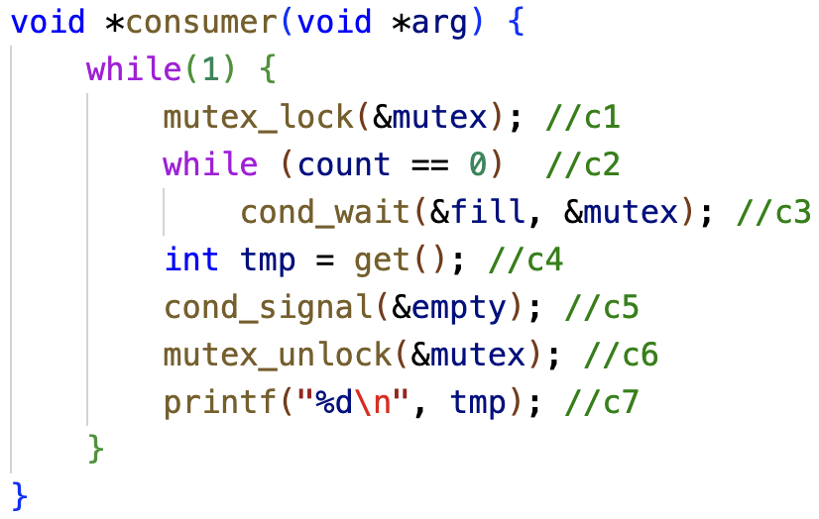
Recap
Producer/Consumer Problem
Condition Variable for Producer/Consumer Problem
Two CVs and while loop

Slide 25
Semaphores
An object with an integer value
Introduced by E. W. Dijkstra
Manipulate with two routines
sem_wait(s) P(s) down(s)
sem_post(s) V(s) up(s)
Motivation: Avoid busy waiting by blocking a process execution until some condition is satisfied

Slide 26
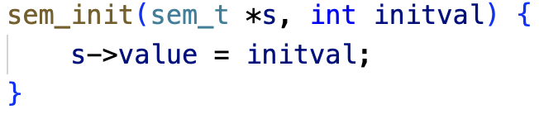
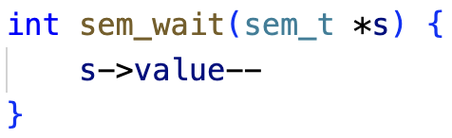
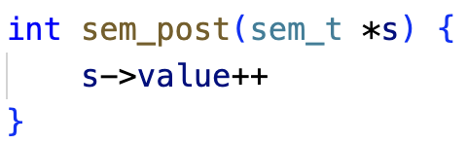
Semaphore Operations
Initialization
Wait or test
Decrements sem value by 1. Waits if value of sem is <0
Signal or post:
Increments sem value by 1. Then wake a single waiter if exists
;
;

Slide 27
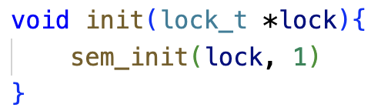
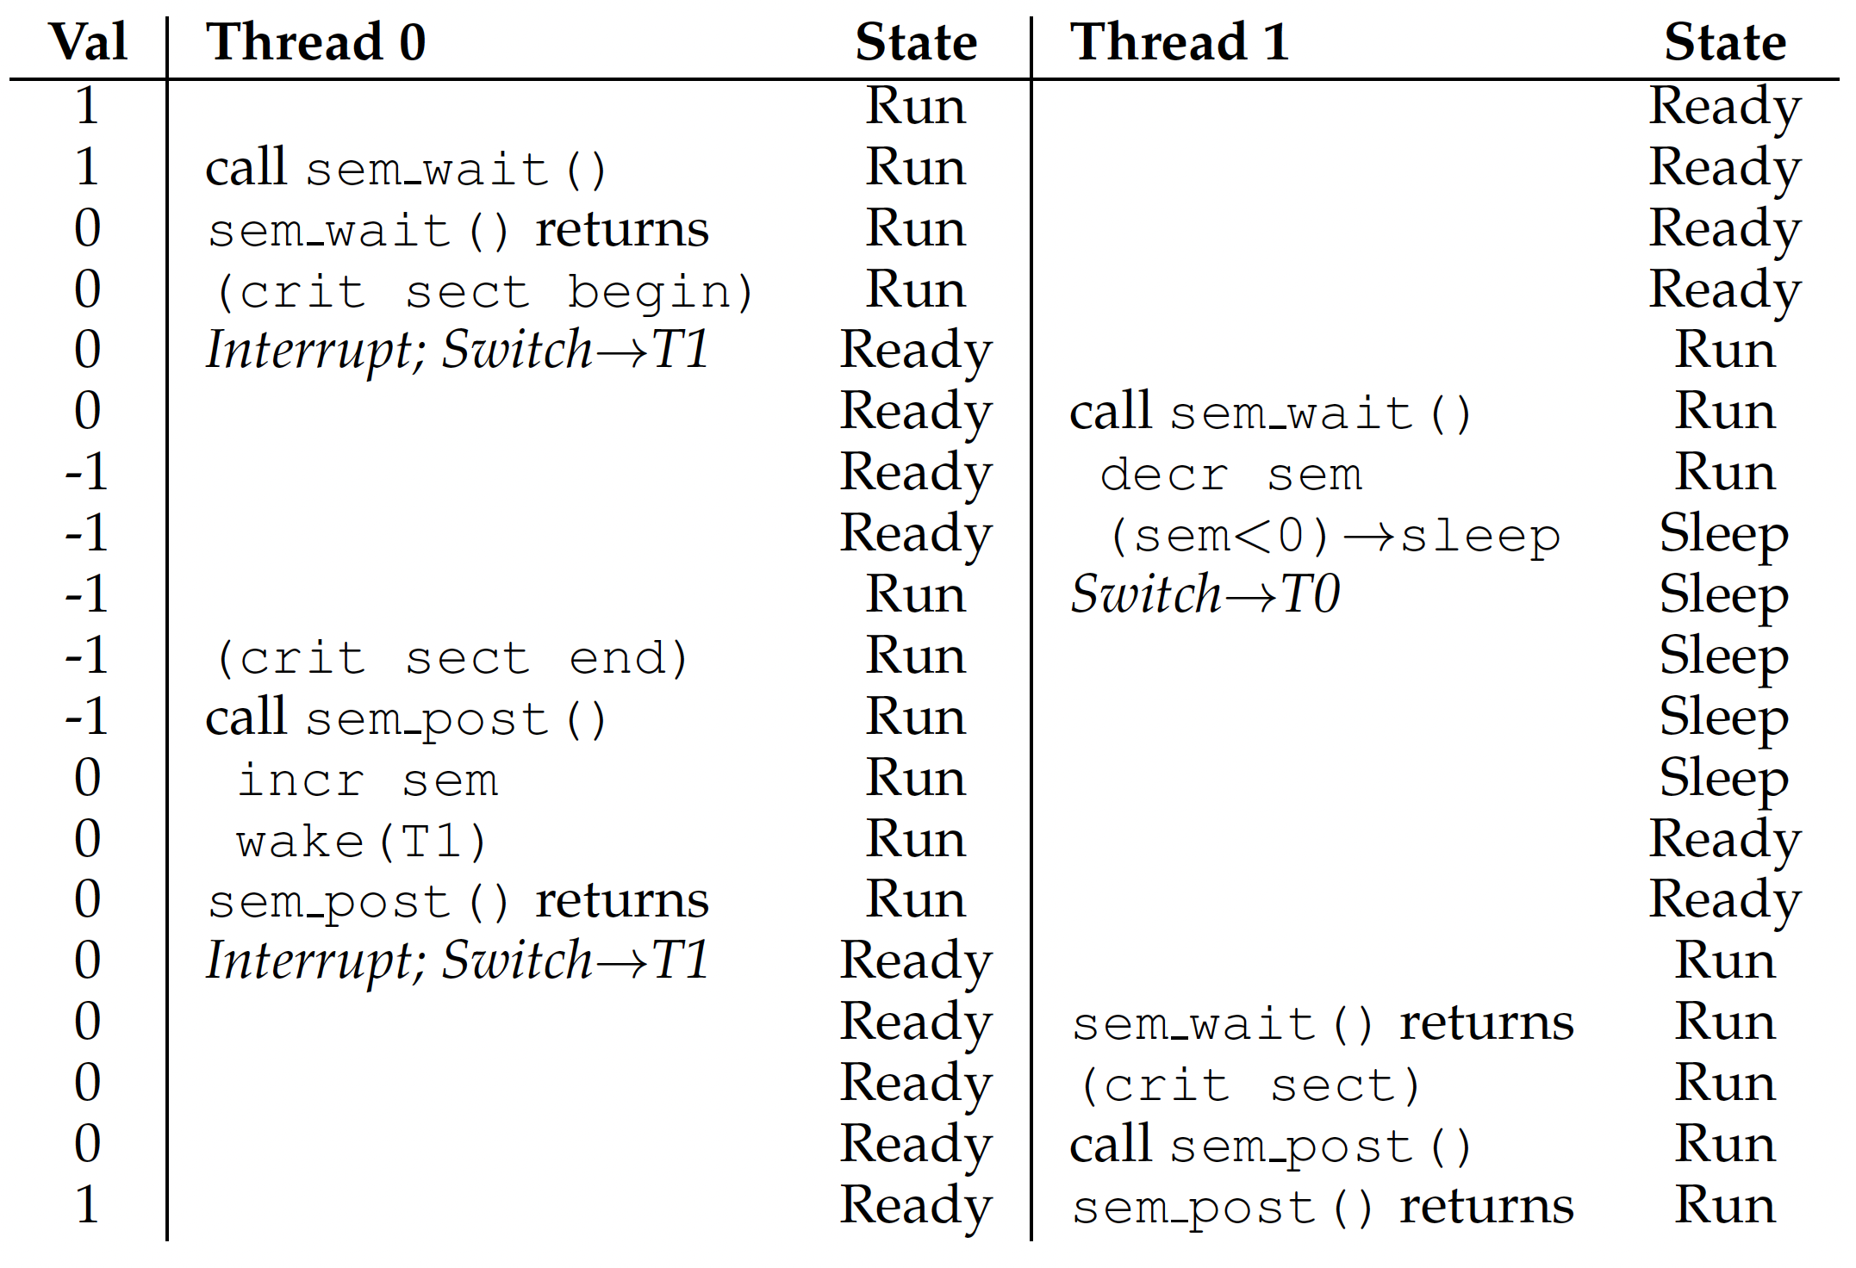
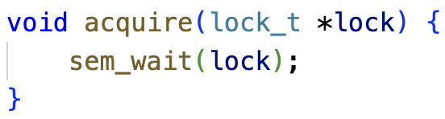
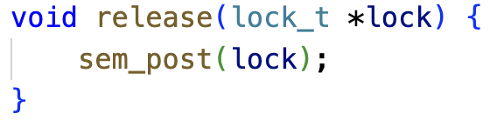
Binary Semaphore
Possible execution trace of two threads using a binary semaphore
Binary Semaphore is a mutex lock

Slide 28
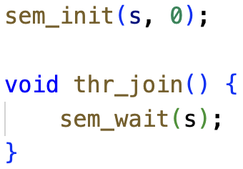
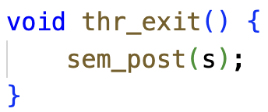
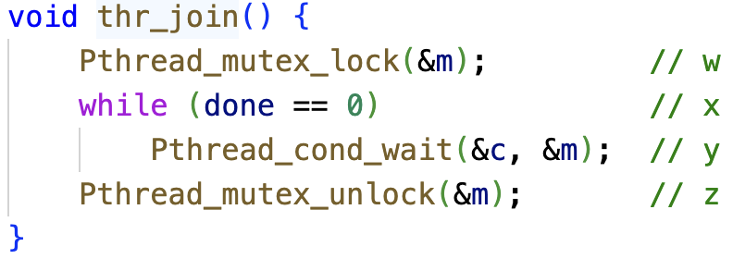
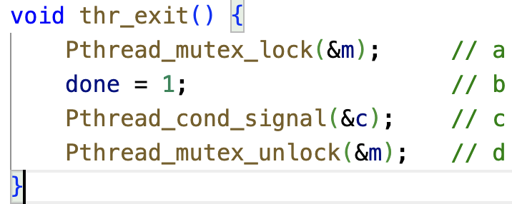
Semaphore for Ordering
Parent call thr_join() and waits for child to complete by calling thr_exit():
Equivalent implementation using a Condition variable (discussed later):

Slide 29
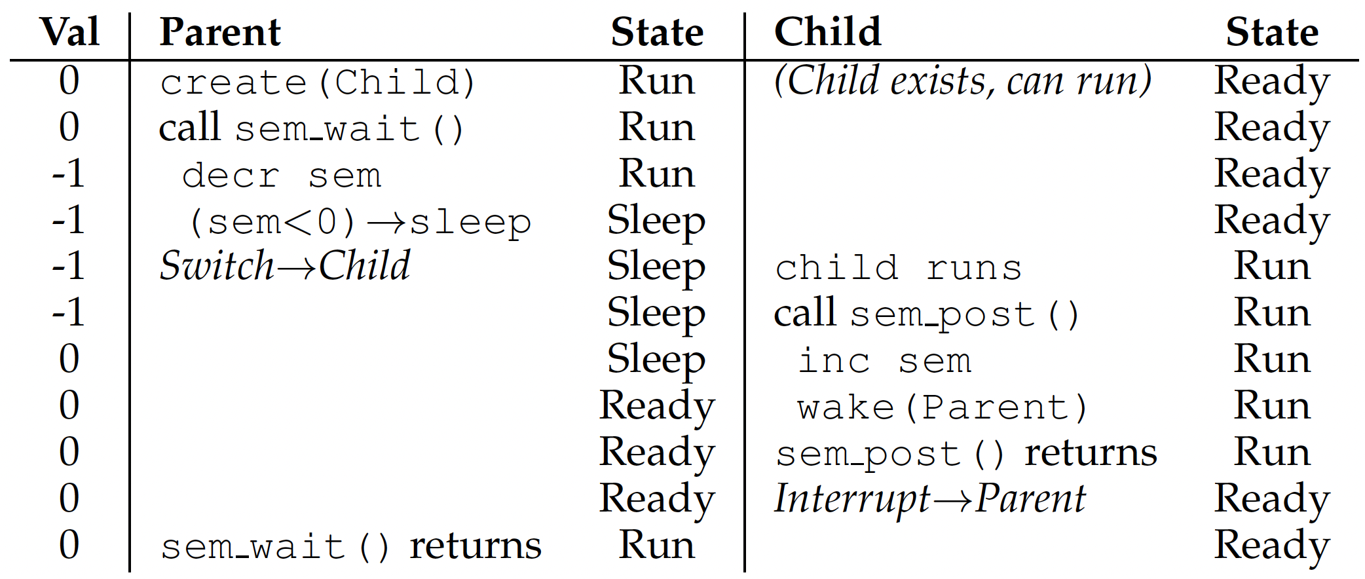
Semaphore for Ordering
Sem=-1 here
Case 1: parent runs first
Sem=-1
Sem=0

Slide 30
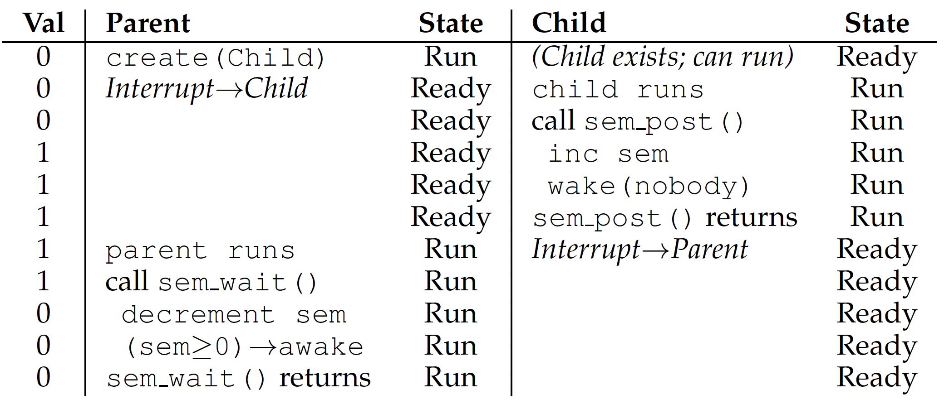
Semaphore for Ordering
Case 2: child runs first
Sem=1
Sem=0

Slide 31
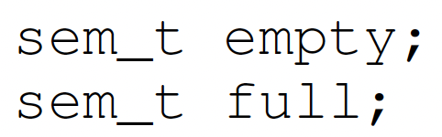
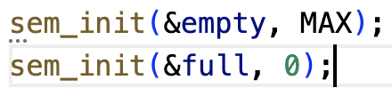
Semaphore for P/C
Shared data:
Initialization:
producer
consumer

Slide 32
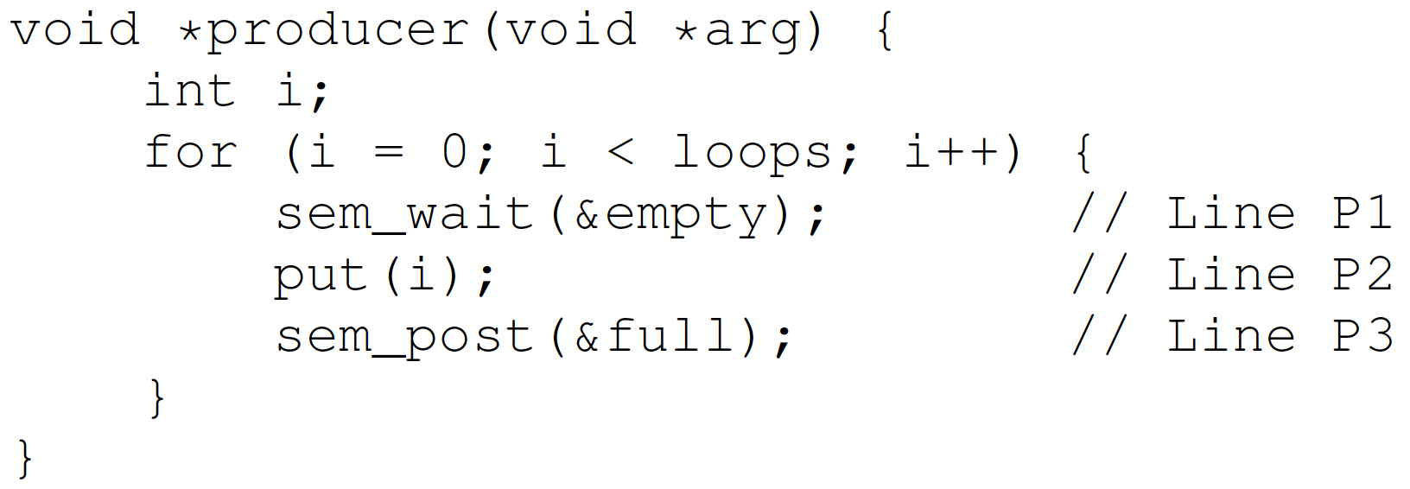
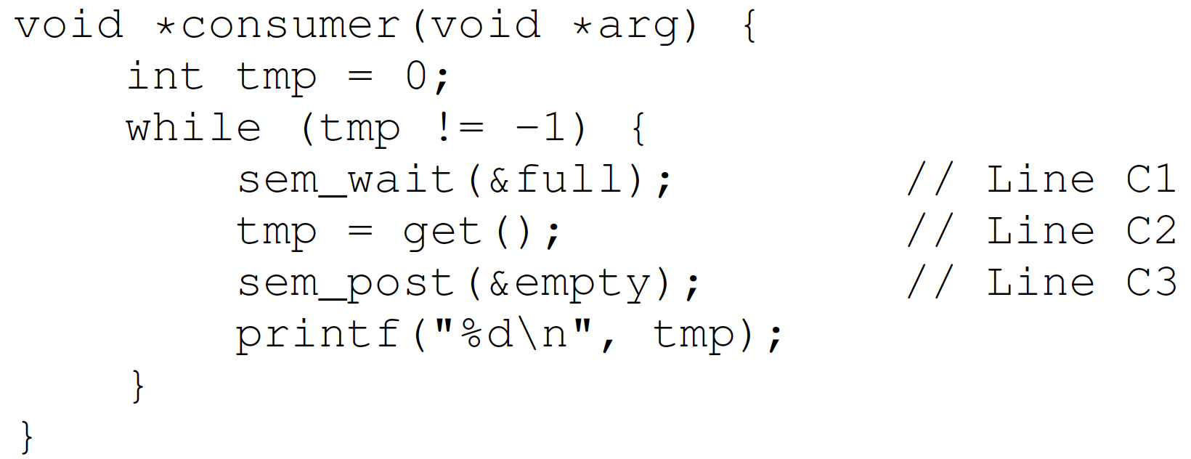
Semaphore for P/C
MAX=1

Slide 33
Semaphore for P/C
MAX > 1
Race condition

Slide 34
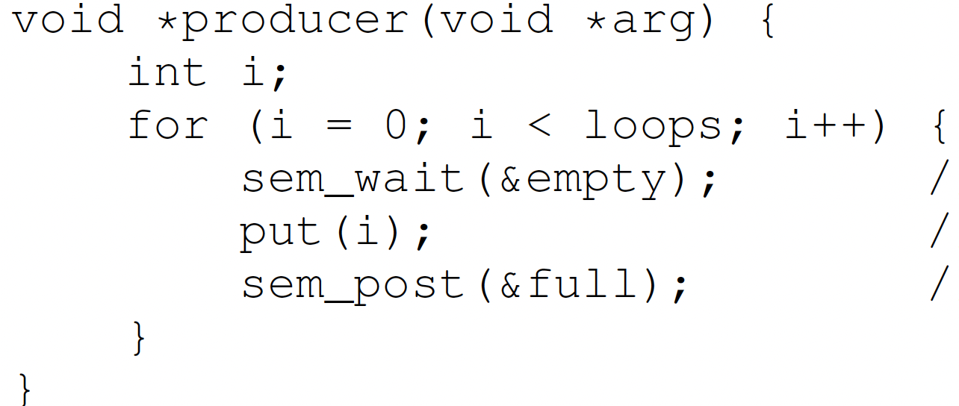
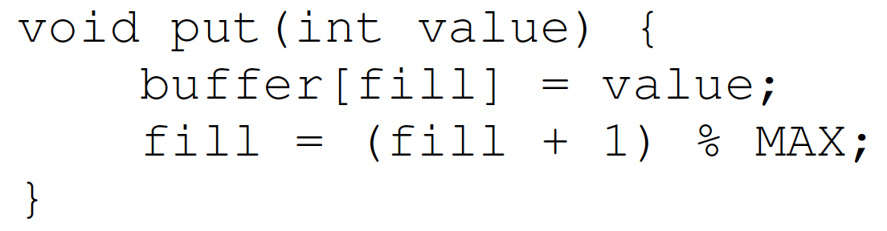
Semaphore for P/C
2 producers
Empty = 9
MAX=10
Producer 1
Producer 2

Slide 35
Semaphore for P/C
2 producers
Empty = 8
Producer 1
Producer 2
Interrupted
When Producer 2 thread preempts/interrupts Producer 1 thread just after it the line buffer[fill]=value, there is a race condition on the global variable fill, so fill is incremented only by 1 instead of by 2.

Slide 36
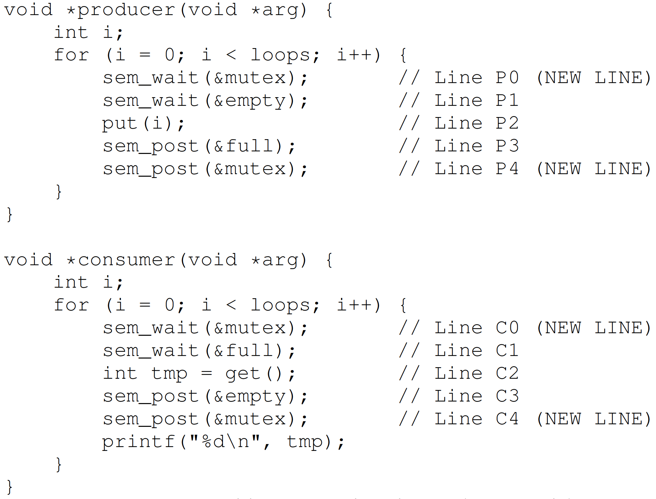
Semaphore for P/C – Mutex
Solution: add a mutex lock

Slide 37
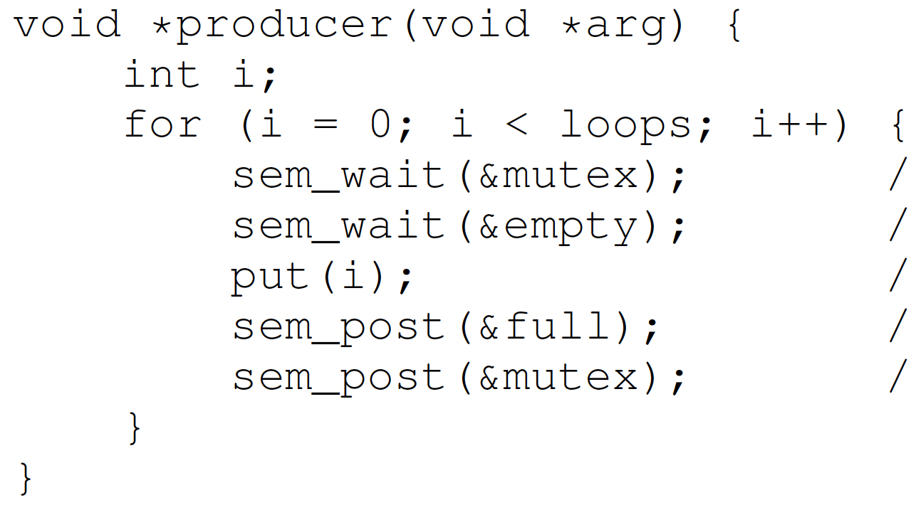
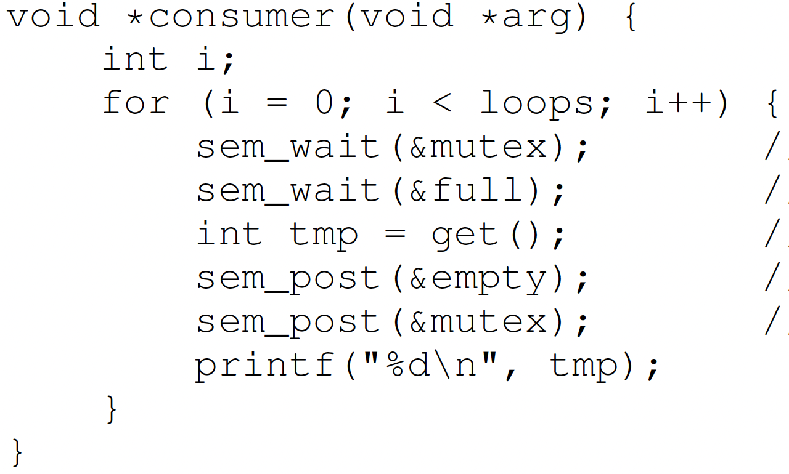
Semaphore for P/C – Mutex
mutex = 1
full = 0
empty = 10

Slide 38
Semaphore for P/C – Mutex
mutex = 0
full = 0
empty = 10
Ready
Wait for lock
Running
Hold lock
Wait for full
Deadlock occurred!

Slide 39
Semaphore for P/C – Mutex
mutex = 0
full = 0
empty = 10
Running
Wait for lock
Block
Hold lock
Wait for full

Slide 40

Deadlock
Definition: A set of threads are said to be in a deadlock state when every thread in the set is waiting for an event that can be caused only by another thread in the set
Conditions for Deadlock
Mutual exclusion
Threads claim exclusive control of resources that require e.g., a thread grabs a lock
Hold-and-wait
Threads hold resources allocated to them while waiting for additional resources
No preemption
Resources cannot be forcibly removed from threads that are holding them
Circular wait
There exists a circular chain of threads such that each holds one or more resources that are being requests by next thread in chain
Wanted
Resource 1
Held
Thread 1
Thread 2
Resource 2
Held
Wanted
Not a perfect analogy, just a fun image!

Slide 41
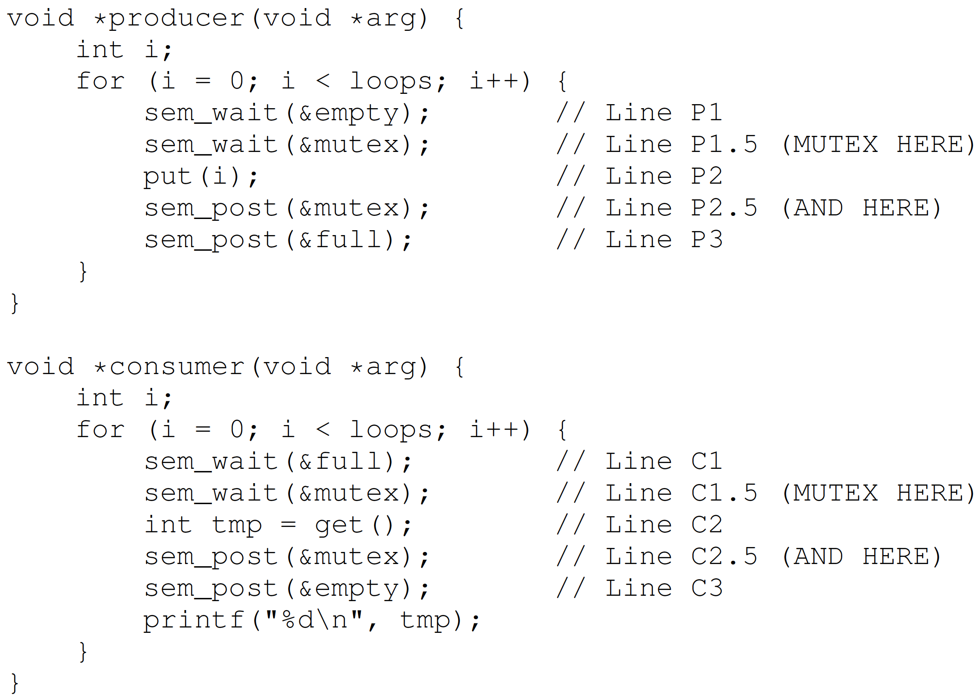
Mutex without Deadlock
Lock just around the critical section

Slide 42
Summary
Semaphores -> locks + condition variables
Binary semaphores -> locks
Semaphore for ordering
Semaphore for P/C

Slide 43
Recap
Locks --- mutual execution
Only one thread must execute critical section
Hardware support – atomical execution
Test-and-set and compare-and-swap
Busy-waiting --- spinlock
Metrics to evaluate locks:
Correctness: mutual execution
Fairness: no starvation
Performance: no high cost to acquire and release a lock
Ticket locks --- No starvation
Queue locks --- No starvation and predictable order

Slide 44
Condition Variables
Producer/Consumer problem
Ordering execution
Condition variable

Slide 45



Producer/Consumer Problem
A classical synchronization problem, also called the bounded-buffer problem
A buffer has a bounded size
Examples of Producer/Consumer Problems:
Web servers:
Producer puts requests in a queue
Consumers picks requests from the queue to process
Unix Pipes
producer
consumer

Slide 46
Producer/Consumer Problem
Producer
Consumer
Bounded buffer
When buffers are full, producer must wait
When buffers are empty, consumer must wait
Synchronization between producers
Synchronization between producers and consumers
Producing/Consuming to/from buffer require locking

Slide 47
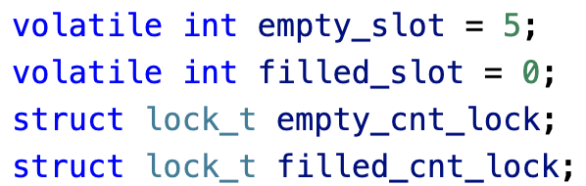
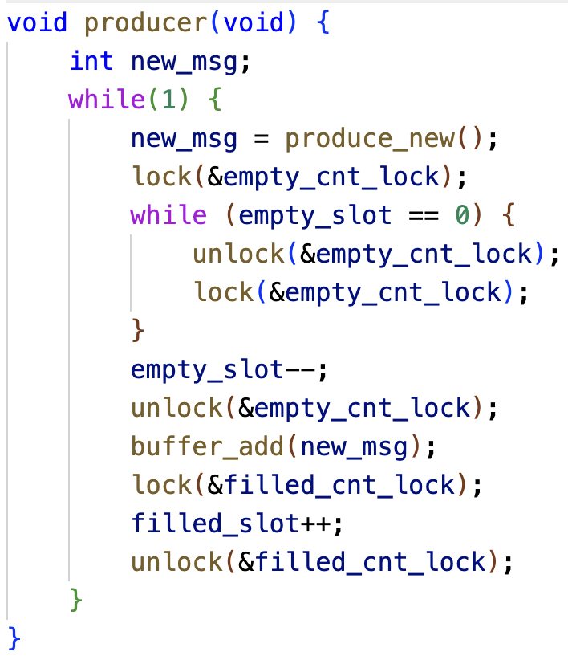
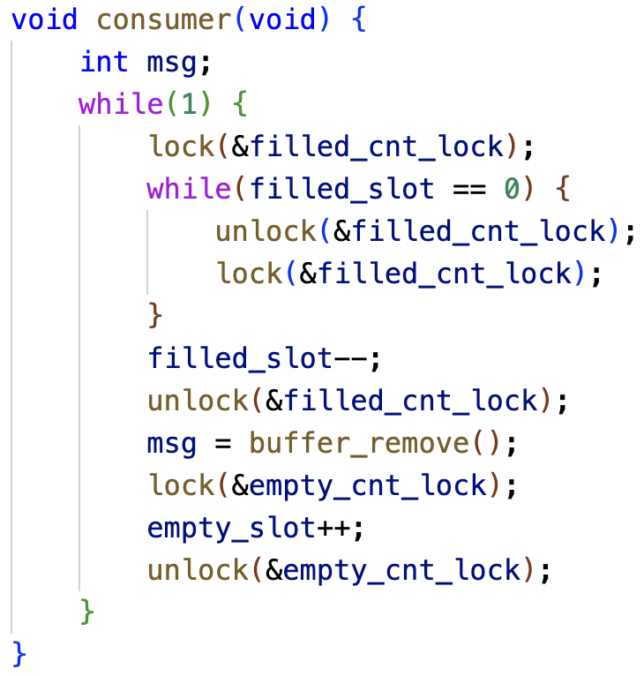
P/C Problems With Only Locks
Busy looping

Slide 48

More Than Mutual Exclusion
Mutual exclusion
No two threads access a critical section at the same time
Thread A and B don’t run at the same time
Locks
Condition
A thread wishes to check whether a condition is true before execution
Thread B runs after thread A completes
Condition variables and semaphores

Slide 49
Condition Variables (CV)
Condition variables are synchronization primitives:
A queue of waiting threads
A thread waits for a condition to be true and can put itself into the queue
Other thread can wake up one or more waiting threads
Used with mutex to prevent race conditions
Two functions:
wait(CV…): put itself on the waiting queue
Signal(CV,…): Send signal to CV when it is done
Notes:
An explicit queue that threads can put themselves
when some condition is not as desired
A conditional variable allows a thread to wait for a particular condition to be true before continuing execution. The thread can signal the condition variable to wake up one or more waiting threads when the condition becomes true.

Slide 50
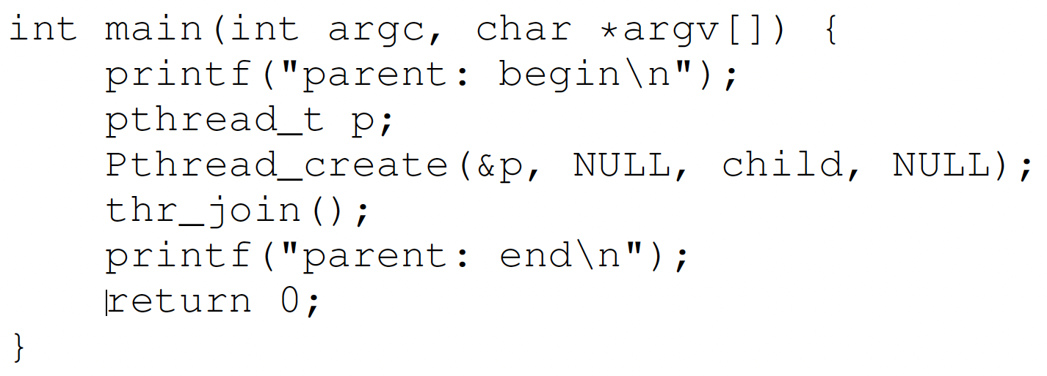
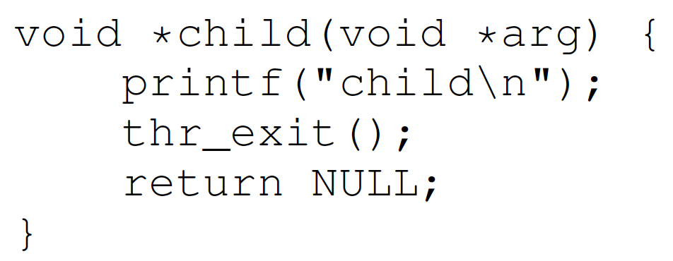
Condition Variables (CV)
A parent waits for the child by calling thr_join(); the child signals completion by calling thr_exit(). We need to implement thr_join() and thr_exit() with CV.
Parent
wait
signal
Child

Slide 51
Incorrect: CV with Only Lock
Child thr_exit() function:
Line A: Child thread locks the mutex (pthread_mutex_lock(&m)).
Line B: It signals the condition variable (pthread_cond_signal(&c)) to notify the parent that it has completed.
Line C: It then unlocks the mutex (pthread_mutex_unlock(&m)).
Parent thr_join() function:
Line X: Parent thread locks the mutex (pthread_mutex_lock(&m)).
Line Y: It waits on the condition variable (pthread_cond_wait(&c, &m)). This releases the mutex and puts the parent to sleep until it is signaled.
Line Z: Once signaled, it reacquires the mutex and then unlocks it (pthread_mutex_unlock(&m)).
The program assumes that the parent will always call thr_join() (and thus wait on the condition variable) before the child calls thr_exit() to signal. If this ordering is not guaranteed, there is a race condition:
If the child calls thr_exit() before the parent starts waiting on pthread_cond_wait, the signal (pthread_cond_signal) may be missed because condition variables do not queue signals if no thread is waiting at that moment. As a result, the parent could block indefinitely on pthread_cond_wait.
//Child
void thr_exit(){
Pthread_mutex_lock(&m);//A
Pthread_cond_signal(&c);//B
Pthread_mutex_unlock(&m);}//C
//Parent
void thr_join(){
Pthread_mutex_lock(&m);//X
Pthread_cond_wait(&c, &m);//Y
Pthread_mutex_unlock(&m);}//Z
Scenario 1: Parent calls thr_join() first. Works correctly.
Parent | X | Y |  |  |  | Z
Child |  |  | A | B | C
Scenario 2: Child calls thr_exit() first. Parent blocks forever!
Parent |  |  |  | X | Y
Child | A | B | C

Slide 52
Incorrect: CV with Flag & Lock
//Child
bool child_done = false; //Shared state
void thr_exit(){
pthread_mutex_lock(&m);
child_done = true; //Set flag
pthread_cond_signal(&c); //Signal parent
pthread_mutex_unlock(&m);
}
//Parent
void thr_join(){
pthread_mutex_lock(&m);
if(!child_done){ //Check flag
pthread_cond_wait(&c, &m);//Wait only if needed
}
pthread_mutex_unlock(&m);
}
Add a Boolean flag child_done:
The child_done flag ensures that even if pthread_cond_signal occurs before pthread_cond_wait, the parent will not block indefinitely because it will detect that child_done is already set.
Spurious wakeup problem:
The program assumes that once the parent thread is awakened, the condition child_done is guaranteed to be true. But it is possible for child_done to be false.
The parent thread may be awakened by the system without any signal from the child thread (i.e., pthread_cond_signal has not been called), since system-level events such as interrupts, signals, or other system-specific mechanisms may cause a thread to wake up prematurely. This is called spurious wakeups.
Notes:
Spurious wakeups usually happen because in between the time when the condition variable was signaled and when the awakened thread was finally able to run, another thread ran first and changed the condition again. In general, if multiple threads are awakened, the first one to run will find the condition satisfied, but the others may find the condition unsatisfied. In this way, there is a race condition between all the awakened threads. The first thread to run will win the race and find the condition satisfied, while the other threads will lose the race, and experience a spurious wakeup’
Example Scenario
The parent thread calls thr_join() and enters pthread_cond_wait.
A spurious wakeup occurs, causing pthread_cond_wait to return prematurely.
Since the condition (child_done) is only checked once with an if, the parent thread assumes it can proceed, even though the child has not yet called thr_exit() or set child_done = true.
The use of a loop around pthread_cond_wait ensures correctness in case of spurious wakeups.

Slide 53
Correct: CV with Flag & Lock
//Child
bool child_done = false; //Shared state
void thr_exit(){
pthread_mutex_lock(&m);
child_done = true; //Set flag
pthread_cond_signal(&c); //Signal parent
pthread_mutex_unlock(&m);
}
//Parent
void thr_join(){
pthread_mutex_lock(&m);
while(!child_done){ //Check flag
pthread_cond_wait(&c, &m);//Wait only if needed
}
pthread_mutex_unlock(&m);
}
Adding a Boolean flag child_done and using while(!child_done) to check the flag, makes the program robust and avoids race conditions.
The child_done flag ensures that even if pthread_cond_signal occurs before pthread_cond_wait, the parent will not block indefinitely because it will detect that child_done is already set.
The use of a while loop around pthread_cond_wait ensures correctness in case of spurious wakeups.

Slide 54
Summary
Producer/consumer problem
Condition variable
Properly use CVs
Have a state
Use mutex to ensure no race condition
Recheck the state (while)
Notes:
2: use mutex to ensure no race between interacting with state and wait/signal

Slide 55
Quiz: Race Conditions
Consider the two threads each executing t1 and t2. Values of shared variables y and z are initialized to 0.
t1:
1 t1(){ |  | t2: | 1 | t2(){
2 | int x; |  | 2 |  | y = 1;
3 | x = y + z; |  | 3 |  | z = 2;
4 } |  |  | 4 | }
Q. Give all possible final values for x and the corresponding order of execution of instructions in t1 and t2.
1) t1 runs to the end first; then t2 runs to the end: x = 0+0 = 0
2) t2 to line 2; then t1 to the end; then t2 to the end: x = 1+0 = 1
3) t2 to the end; then t1 to the end: x = 1+2 = 3
Are there other possibilities giving additional values?

Slide 56
Quiz: Race Conditions
Addition operation x=y+z consist of multiple machine instructions in assembly language:
fetch operand y into register r1
fetch operand z into register r2
add r1 + r2, store result in r3
store r3 in memory location of x
If a task switch to t2 occurs between machine instructions A and B; then t2 runs to completion before switching back to t1, then:
y is read as 0 (t2 didn’t set y yet)
z is read as 2 (t2 sets z before execution instruction B of add. in t1)
the sum is then x = 0 + 2 = 2
t1: |  |  | t2:
1 t1() { |  |  | 1 t2() {
2 | int x; |  | 2 | y = 1;
3 4 } | x = y + z; |  | 3 4 } | z = 2;

Slide 57
Quiz: Race Conditions
Q. Give a solution using semaphores and wait/signal operations.
Solution: we protect the addition x = y + z within a critical section, using a binary semaphore (mutex). This code guarantees that x can never have the value 1 or 2, possible values are x = 0, 3 (Line “int x” can be outside or inside the critical section with no difference.)
t1:
0 sem s = 1; |  | t2: | 1 t2() {
1 t1() { |  |  | 2 s.wait();
2 | int x; |  | 3 y = 1;
3 | s.wait(); |  | 4 z = 2;
4 | x = y + z; |  | 5 s.signal();
5 | s.signal(); |  | 6 }
6 }

Slide 58
Quiz: Semaphores
t1:
1 int t1() { |  | t2: | 1 int t2() {
2 | printf("w"); |  | 2 | printf("o");
3 | printf("d"); |  | 3 | printf("r");
4 } |  |  | 4 | printf("l");
 |  |  | 5 6 } | printf("e");
Q. Use semaphores and insert wait/signal calls into the two threads so that only “wordle” is printed.
t1: t2:
t1 has to run first to print "w", so s1 should be initialized to 1.
t2 has to wait until the "w" has been printed by t1, then it is woken up by t1 calling s2.signal(), so s2 should be initialized to 0.
0 sem s1=1,s2=0; 1 int t2() {
1 int t1() {
2
3
4
5
6
7
8
9 }
s2.wait();
printf("o");
printf("r");
s1.signal();
s2.wait();
printf("l");
printf("e");
2
3
4
5
6
7
8 }
s1.wait();
printf("w");
s2.signal();
s1.wait();
printf("d");
s2.signal();
Notes:
It is signalled by t1, so the initial value of s2 has to be 0.

Slide 59
Quiz: Semaphores II
int t1() {
while(1) {
printf("A");
s_c.signal();
s_a.wait();
6 }
7 }
int t2() {
while(1) {
printf("B");
s_c.signal();
s_b.wait();
6 }
7 }
int t3() {
while(1) {
s_c.wait();
s_c.wait();
printf("C");
s_a.signal();
s_b.signal();
8 }
9 }
semaphore s_a=0, s_b=0, s_c=0;
Q. Which strings can be output when running the 3 threads in parallel?
Either t1 or t2 could start first, so the first letter can be A or B
Then both t1 and t2 signal s_c, only after both have signalled s_c, t3 can start and print C
t3 signals s_a and s_b, which start in arbitrary order again
Accordingly, the output is a regular expression ((AB|BA)C)+
Print A or B in arbitrary order, then print C, then the process repeats
Notes:
Here, we have used a regular expression to indicate the structure of a text pattern. Regular expressions (short: regexps) are a common tool in Unix

Slide 60
Quiz: Deadlocks
int x=0, y=0, z=0; semaphore lock1=1, lock2=1;
1 int t1() { 1 int t2() {
2
3
4
5
6
7
8
9 }
z = z + 2; lock1.wait(); x = x + 2;
2
3
4
5
6
7
8
9 }
lock2.wait();
y = y + 1; lock1.wait(); x = x + 1;
lock1.signal(); lock2.signal(); z = z + 1;
lock2.wait(); lock1.signal(); y = y + 2; lock2.signal();
a. Executing the threads in parallel could result in a deadlock. Why?
t1 runs first until line 4 (so lock1=0, lock2=1) ↯ switch to t2
t2 starts and runs until line 3 (so lock1=0, lock2=0) ↯ back to t1
t1 waits for lock2 in line 5 ↯ switch to t2, waits for lock1 in line 4
This results in a mutual waiting condition which is not resolved
Note that this deadlock does not occur in all execution/task switch orders!

Slide 61
Quiz: Deadlocks
int x=0, y=0, z=0; semaphore lock1=1, lock2=1;
1 int t1() {
2 z = z + 2;
lock1.wait();
x = x + 2;
lock2.wait();
lock1.signal();
y = y + 2;
lock2.signal();
9 }
1 int t2() {
2
3
lock2.wait();
y = y + 1; lock1.wait(); x = x + 1;
lock1.signal(); lock2.signal(); z = z + 1;
4
5
6
7
8
9 }
Q. Executing the threads in parallel could result in a deadlock. Why?
t2 runs first until line 2 (so lock2=0, lock1=1); switch to t1
t1 starts and runs until line 3 (so lock1=0, lock2=0); back to t2
t2 waits for lock2 in line 4; switch to t1, waits for lock1 in line 5
Note: There are other possible interleavings, as long as each thread grabs one lock and requests the other. You can remove all other statements and only leave the lock wait() instructions and get into this deadlock.)
Notes:
Are there other execution orders leading to a deadlock?

Slide 62
Quiz: Deadlocks
int x=0, y=0, z=0; semaphore lock1=1, lock2=1;
Q. What are the possible values of x, y and z in the deadlock state?
t1 runs until Line 5 lock2.wait() and t2 runs until Line 4 lock1.wait(), so x = 2, y = 1, z = 2
Q. What are the possible values of x, y and z if the program finishes successfully without a deadlock?
t1 runs first to the end, then t2 (or vice versa): x=3, y=3, z=3
In t1, lock1.signal() sets lock1=1, lock2.signal() sets lock2=1, this exiting the critical sections protected by lock1 and lock2.
Since Line 2 of t1 “z=z+2”, and Line 8 of t2 “z=z+1” are not protected within a critical section, a thread switch may occur in the middle of each line, e.g.,
t2 Line 8 reads z=0; before z is written back; switch to t1 Line 2, run t1 to the end; switch to t2 Line 8, write back z=0+1=1.
Or, t1 Line 2 reads z=0; before z is written back; switch to t2 Line 2, run t2 to the end; switch to t1 Line 2, write back z=0+2=2.
Note: to prevent deadlocks, every thread should acquire locks in the same order, e.g. both acquire lock1 before lock2, or both acquire lock2 before lock1
1 int t1() { |  |  | 1 | int t2() {
2 | z = z + 2; |  | 2 |  | lock2.wait();
3 | lock1.wait(); |  | 3 |  | y = y + 1;
4 | x = x + 2; |  | 4 |  | lock1.wait();
5 | lock2.wait(); |  | 5 |  | x = x + 1;
6 | lock1.signal(); |  | 6 |  | lock1.signal();
7 | y = y + 2; |  | 7 |  | lock2.signal();
8 | lock2.signal(); |  | 8 |  | z = z + 1;
9 } |  |  | 9 | }

